Slide 1
Mental Health Services Act Overview FY 20/23
Developed by the Mental Health Services Act Division, Alameda County Behavioral Health Department
Notes:
WELCOME & INTRODUCTION
Review presentation objectives:
Participants will review MHSA
Identify five MHSA Plan components
Identify 3 themes for the MHSA Three-Year Plan
Identify 3 MHSA programs targeting African Americans

Slide 2
MENTAL HEALTH SERVICES ACT (MHSA)
The Mental Health Services Act (MHSA) emphasizes Transformation of the Mental Health System and Improving the Quality Of Life for people living with mental illness and those at-risk for mental illness and/or mental health challenges.
In 2004, California voters passed Proposition 63, known as the Mental Health Services Act
Funded by 1% tax on any personal incomes over $1 million.
In Alameda County, the Alameda County Behavioral Health (ACBH) Department operates and/or administers services programs, projects, and initiatives developed and contracted through MHSA funding.
Notes:
Handout: MHSA 101 FAQ
The Mental Health Services Act (MHSA) funds mental health services in California through a one percent tax on personal annual incomes that exceed one million dollars. The MHSA is also known as Proposition 63. It is made up of five components, described below, that are designed to expand and transform California’s mental health systems to better serve individuals with and at risk of serious mental health issues and their families. Locally, Alameda County Behavioral Health (ACBH) MHSA Division is the agency that administers MHSA funding.
Funding is budgeted on a three-year cycle. The funding divisions are shown below.
ACBH’s MHSA Website and Contact information
Visit the MHSA website at https://acmhsa.org/ to find the most up-to-date information. If you have questions or want information about a speaker, please contact MHSA@acgov.org.

Slide 3
MHSA: WHO DOES IT SERVE?
Individuals with serious mental illness (SMI) and/ or severe emotional disorder (SED)
Individuals not served /underserved by current mental health system
Voluntary services
**Non-supplantation: MHSA may not replace existing program funding or use for non-mental health programs.
Notes:
Currently individuals on parole can not be served by MHSA funding however SB 389 will change regulations to allow MHSA funds (if no other funds are available) for MH services for those on parole.

Slide 4
MHSA FIVE PLAN COMPONENTS: AFRICAN AMERICAN FOCUSED PROGRAMS
Community Services & Supports | Prevention & Early Intervention | Workforce, Education & Training | Capital Facilities & Technological Needs | Innovative Programs (not AA specific)
4 ongoing programs | 6 ongoing programs | 2 programs and strategies | 1 projects | 3 approved projects 1 pending project
$1.59M annually | $1.43M annually | $227,413 annually | $6M/three fiscal years | $6.3M
Notes:
The Five MHSA Components
Community Services and Supports (CSS) uses funds for direct services to adults with severe mental illness and children with severe emotional disturbance.
Prevention and Early Intervention (PEI) services embrace an approach that engages individuals before the development of mental illness, as well as, provide services to intervene early to reduce mental health symptoms.
Innovation (INN) involves the funding and evaluation of new approaches to increase access to underserved communities, promotion of interagency collaboration, and increasing the overall quality of mental health services.
Workforce, Education, and Training (WET) develops a workforce for ACBH that is sufficient in size, diverse, and linguistically capable to deliver services and supports that are culturally responsive to clients and family members.
Capital Facilities and Technological Needs (CFTN) makes provisions for building projects and improvement of mental health services delivery by increasing technological capacity through funding.
Funding
Funding is budgeted on a three-year cycle. The funding divisions are shown below
Funding Restrictions
CSS allocation: at least 50% must be spent on “Full Service Partnership clients”
PEI allocation: >50% must be spent on activities that serve clients age 25 or younger.
INN: One-time innovative projects that address a “learning question” with duration of no longer than 5 years
Counties are required to conduct a Community Planning Process (CPP) every 3 years in relation to their Three Year MHSA Plan.
Current Program Summary (as identified in Three-year Plan FY 20/23)
CSS: ongoing programs with 51 providers (14 FSPs and 37 OESD) at $88.23M annually
PEI: 41 ongoing programs at $15.1M annually
WET: 11 programs and strategies at $3.3M
CFTN: 4 projects at $13.6M
INN: 3 approved + 1 pending at $6.3M
African-American focused programs:
During the previous MHSA Three-Year Plan FY 17/18-19/20 ACBH set aside $2M specifically to provide services to the African American community ($1M in CSS and $1M in PEI). Listed below are the allocations, by component, from the original $2M set aside as well as additional funding that has been identified, e.g. second faith-based program (PEI), the increase in budget to the Black Men Speak Program (PEI), workforce education and training (WET) funds and Capital Facilities and Technological Needs (CFTN) funds towards the development of the African American focused Wellness Hub. A total of Highlights:
developing an African American Wellness Hub Complex for a total of $6M over Thee-Years
Developing a culturally responsive COVID-19 outreach campaign wherein the ACBH Office of Ethnic Services will also host a second wave of information and education during FY 20/21

Slide 5
MHSA AFRICAN AMERICAN FOCUSED PROGRAMS CONT’D…
Hiawatha Harris-pathways – Proper Diagnosis & Medication Training
Roots Community Health Center – Re-entry Services for SMI adult clients
ACBH Housing – MH Wellness supports at housing sites (in progress)
Multiple Consultants – Planning for the AA wellness Hub
Beats Rhymes & Life: TAY Focused PEI Services
PEERS: Black Men Speak, Speakers Bureau & Faith-based Stigma Reduction & Training
Mental Health Association: AA Family Support Groups and loved ones with SMI/SED
Rjoy: Emotional Support Groups
Tri Cities Community Development Center: Faith-based Stigma Reduction & training
ACBH: African-American Focused Conference & TA/Capacity Building for African American Health and Wellness Committee (based on annual approval and available revenue)
ACBH: Capital Facility development for African American Focused Wellness Hub
Notes:
During the previous MHSA Three-Year Plan FY 17/18-19/20 ACBH set aside $2M specifically to provide services to the African American community ($1M in CSS and $1M in PEI). Listed below are the allocations, by component, from the original $2M set aside as well as additional funding that has been identified, e.g. second faith-based program (PEI), the increase in budget to the Black Men Speak Program (PEI), workforce education and training (WET) funds and Capital Facilities and Technological Needs (CFTN) funds towards the development of the African American focused Wellness Hub.
Highlights:
developing an African American Wellness Hub Complex for a total of $6M over Thee-Years
Developing a culturally responsive COVID-19 outreach campaign wherein the ACBH Office of Ethnic Services will also host a second wave of information and education during FY 20/21

Slide 6
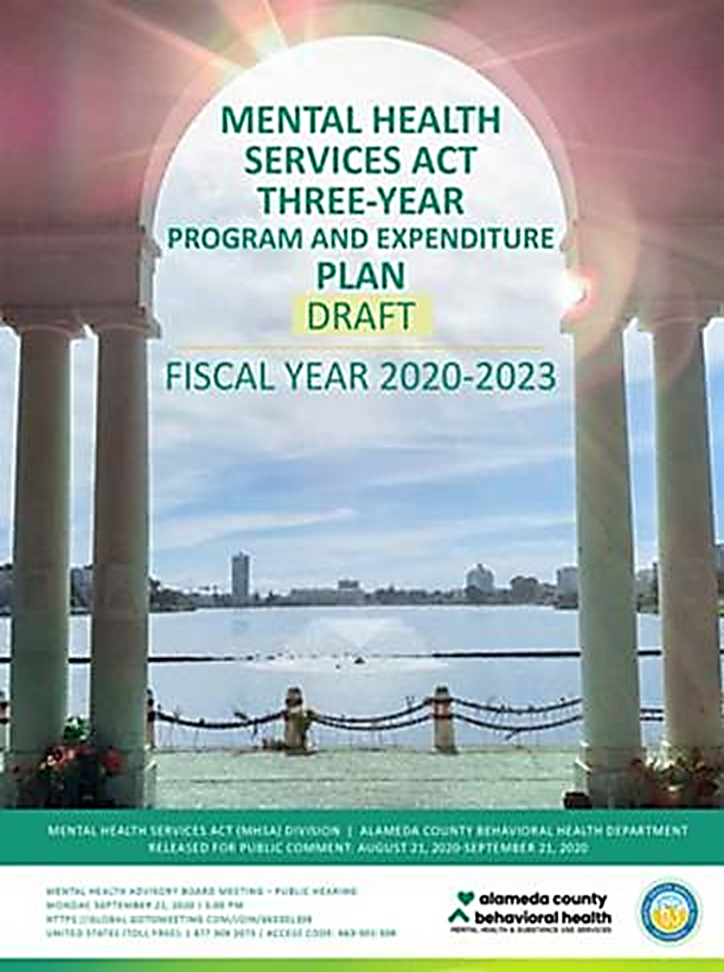
What is the mhsa three-year plan?
Notes:
Spending plan for a gov. budget, is a strategic tool to manage money. pertains to the MHSA money to be set aside/appropriated for local productive purposes, like supporting various projects. CA law through CDMH – MHSOAC (16 member committee) contracts with local counties and two cities to develop and manage the implementation of MHSA. CA law gives ALCO/ACBH the ability to administer funds:
Helps in tracking the amount of income or revenue available (transparency)
Stakeholder process used to making decisions on how to use this income and also to save some (oversight)
Overview of our programs & performance which served to justify spending decisions
The importance of MHSA support is well known to our department, as a proportion of overall mental health funding in Alameda County has grown over time. For State Fiscal Year (FY) 20/21, ACBH set aside up to $136,071,268 million in budget authority, which is an approximate 55% increase over the previous Three-Year Plan budget (starting in FY 17/18). This increase in budget authority has primarily been driven by the need for additional homelessness and housing supports, new crisis programming, increased capacity in our Full-Service Partnership (FSP) programming, additional school-based supports and increased culturally responsive services.
Within the past few years all counties in California have experienced high MHSA allocations due to the success of the California economy. However, it should be noted that as a result of the Novel Coronavirus (COVID-19), it is anticipated that in future years, beginning in FY 21/22, ACBH’s MHSA allocation will be reduced and potential contract right sizing or reduction strategies may be initiated. At this time, the actual fiscal impacts or potential reductions associated with COVID-19 are unknown. Nonetheless, in order to be proactive and safeguard against significant impact on the Alameda County community, fiscal planning to evaluate and strategize surrounding a future change in our financial landscape will be initiated this Fall. Additional information on these reductions will be included within the FY 21/22 MHSA Plan Update.

Slide 7
MHSA THREE YEAR PLAN/PLAN UPDATE PROCESS
County mental health programs shall prepare and submit a Three-Year Program and Expenditure Plan (Plan) and Annual Updates for Mental Health Service Act (MHSA) programs and expenditures.
Alameda County’s Three-Year Plan: FY 20/21-22/23
The Mental Health Board shall conduct a public hearing on the draft Three-Year Plan/Plan Update at the close of the 30-day public comment period.
30 day public comment period: August 21-September 21, 2020
Plans and Annual Updates must be adopted by the county Board of Supervisors (BOS) and submitted to the Mental Health Services Oversight and Accountability Commission (MHSOAC) within 30 days after Board of Supervisor adoption.
BOS Health Committee October/November
For INN projects MHSOAC Approval
Full BOS adoption: October/November
MH Board Hearing: September 21, 2020 at 5PM
Notes:
Per WIC code 5487 and 5848
Please visit https://acmhsa.org to review the plan and submit public comments by 9/21/20 5PM

Slide 8
MHSA THREE-YEAR PLAN: CURRENT THEME
Alameda County Demographics
Diversity
Gentrification
COVID-19 :
Community Stress
Resource Disparities
Administrative barriers (budget impact)
Social Justice Initiatives
ACBH Organizational Improvement Strategies
Notes:
FY20/23 PLAN Theme, Style & influences :
Significant changes from the FY 2017-20 Three-Year Plan that are incorporated into the FY 2020-23 Three-Year Plan are in response to the CPPP and operationalized through a three-pronged departmental lens: that of Alignment, Communication, and Organizational Structure. Specifically, we have determined it to be critical for the success of our MHSA strategies and programs to both be reflective of our community needs and supported through departmentwide organizational improvement strategies. Our CPPP and implementation of our new Three-Year Plan will primarily focus on our Alignment with county, agency and departmental mission, vision, values; improving Communication (internal/external stakeholders); and improving our Organizational Structure and service delivery:
New branding standards: Report that reflects ACBH’ brand identity, such as: personality, tone, sensitivity to our audience, font , graphic elements, messaging, Logo, size , MHSA colors. (Featured art from the HHREC Health Through Art program)
Engaging & User friendly - process towards condensing info (unlike CCHS IS 73-Pages): our plan is 592 pages BUT we’ve added new plan program summaries, executive summary , QA/QI, photos, Appendices & Acknowledgements , photos
Address local social issues : new ACBH organizational changes, social justice issues, and COVID-19
Cross-Component findings:
Alameda County Demographics: Alameda County is the seventh most populous county in California, with the City of Dublin being one of the 15 fastest growing cities in the United States. Compared to neighboring Bay Area counties, Alameda, experienced the highest numeric increase in population from 2018 to 2019 with over 4,500 people and the third highest percent of foreign-born residents (32.4%). Since the 2010 Census, the population has increased 10.70%, the highest of any Bay Area County but (1) the number of children is decreasing and overall the county is aging; (2) Alameda ranks as one of the most diverse counties, consisting of 10.3% Black or African-American ( a stead decline from previous census years); and (3) Compared to the general Alameda County population the unhoused population has an overrepresentation of Black or African American at 47%
Local Trends Impact Report: COVID-19 and unemployment and homelessness rates represent indicators of the overall economic health of Alameda County and reflect an increased need for public mental health services. Examination of the impacts of the shelter-in-place policy on unemployment, housing and homelessness, and environmental data over time suggest that MHSA funded providers may be called upon to serve more people in need, especially as the pandemic continues possibly into the Fall.
Factors Related to Budget Expenditures: Expenditures to support an enhanced behavioral system of care through Community Services and Supports comprises 76 cents out of every Mental Health Services Act dollar. This proportion is in keeping with Welfare and Institutions Code Section 5892, which specifies the percentage of Mental Health Services Act monies to be expended on each component. However, it should be noted that as a result of the Novel Coronavirus (COVID-19), it is anticipated that in future years, beginning in FY 21/22, ACBH’s MHSA allocation will be reduced and potential contract right sizing (reorg/restructure by reducing contract workforce, costs cutting, reorganize upper level management) or reduction strategies may be initiated. At this time, the actual fiscal impacts or potential reductions associated with COVID-19 are unknown. Nonetheless, in order to be proactive and safeguard against significant impact on the Alameda County community, fiscal planning to evaluate and strategize surrounding a future change in our financial landscape will be initiated this Fall. Additional information on these reductions will be included within the FY 21/22 MHSA Plan Update

Slide 9
FY 20/23 MHSA THREE YEAR PLAN COMMUNITY PROGRAM PLANNING PROCESS (CPPP)
Community input commenced April 21, 2020 through May 31, 2020 reaching more than 14,069 community members
Conducted 12 focus groups and 198 participants (interpretation services upon request)
Launched an online community input survey resulting in 627 responses
Partnering with the Alameda County Pool of Consumer Champions and the Alameda County MHSA Stakeholder Committee.
Information gathered through the CPPP will assist ACBH in making resource decisions, including new Innovation project ideas. CPPP data is included in the FY 20/21-22/23 Three Year Plan.
Notes:
Alameda County utilizes five MHSA principles (Cultural Competence, Community Collaboration, Client/Consumer/Family Involvement, Integrated Services Delivery, and Wellness & Recovery) to guide planning and implementation activities and employs a range of strategies to engage stakeholders at all levels of planning and implementation. Our CPPP provides a number of opportunities for a 14-member stakeholder group and other representatives to participate in the development of our Three-Year Plans and Annual Updates and stay informed of our progress in implementing MHSA-funded programs. During FY 19/20, MHSA increased the membership of the MHSA Stakeholder Group (MHSA-SG) by 27% and its underserved and unserved demographics by 150%. The group shall include representatives of unserved and/or underserved populations and family members of unserved/underserved populations. This ensures that stakeholders that reflect the diversity of the demographics of the County, including but not limited to, geographic location, age, gender, and race/ethnicity have the opportunity to participate in the Community Program Planning Process.
Despite health factors precluding our department from convening large in-person forums due to COVID-19, ACBH has been committed to identifying creative ways in which to engage the community and various stakeholders over the course of our planning efforts. Launched on April 27, 2020 through May 31, 2020, our CPPP consisted of more than 14,069 community input invitations via a social justice public relations firm, social media, e-mail requests, and creation of a new Community Input webpage with 2,145 new users. A community input survey was translated into 7 threshold languages with 627 unduplicated completions, which was a 14% increase from the previous CPPP survey completion rate in FY 17/18.
The MHSA team coordinated 12 focus groups with more than 198 group participants, each representing an important cross section of Alameda County populations. Some reoccurring themes from focus groups and surveys included: requests for housing and homelessness programs, school-based wellness programs, long-term mental health care and substance abuse treatment programs to combat depression and suicide, digital kinship villages, subacute and acute beds, increased license board and care facilities, and requests to target services for underserved and unserved communities- specifically African-Americans, transitional-age youth, persons experiencing homelessness and immigrants & refugees.
In summary, ACBH has aggressively approached its CPPP process in a manner designed to eliminate as many barriers as possible to promote inclusive outreach and engagement. Our resulting MHSA Three-Year Plan for fiscal years 2020-23 are reflective of a Departmental recalibration and attempt to regard our valuable stakeholder feedback with a commitment towards Alignment, Communication, and Organizational Structure. Our goals are to create a basis for future efforts that represent a variety of stakeholder and community needs such as culturally-relevant, clinically pragmatic, and community-centered support and care. We are pleased to present our process, plans, and commitment to the future of our county with you at this time.

Slide 10
ALAMEDA COUNTY PROFILE: AFRICAN AMERICANS
Alameda, experienced the highest numeric increase in population from 2018 to 2019 with over 4,500 people and the third highest percent of foreign-born residents (32.4%). Since the 2010 Census, the population has increased 10.70%, the highest of any Bay Area County
African Americans comprise 10-11% of the population and comprise 47% of the unhoused population
Africa-Americans have the 3rd highest number of Medi-Cal beneficiaries (n=86,084) and the 2nd highest Med-Cal penetration rate (8.0%)
African Americans are disproportionately impacted by COVID-19 and have the 2nd highest mortality rate ( at the time of plan development African Americans represented 22.2% of deaths)
Notes:
Cross-Component findings:
Alameda County Demographics: Alameda County is the seventh most populous county in California, with the City of Dublin being one of the 15 fastest growing cities in the United States. Compared to neighboring Bay Area counties, Alameda, experienced the highest numeric increase in population from 2018 to 2019 with over 4,500 people and the third highest percent of foreign-born residents (32.4%). Since the 2010 Census, the population has increased 10.70%, the highest of any Bay Area County :
The number of children is decreasing and overall the county is aging
Alameda ranks as one of the most diverse counties, consisting of 10.3% Black or African-American ( a stead decline from previous census years);
Compared to the general Alameda County population the unhoused population has an overrepresentation of Black or African American at 47%,
The penetration rate is the percentage of eligible Medi-Cal insured individuals who are utilizing mental health services. Despite having the second highest number of beneficiaries, Asians have the lowest penetration rate at 1.1%. Alaska Native/American Indian represent the highest penetration rate (8.3%), with the other rates by race/ethnic groups penetration rates as follows 8.0% of Black/African Americans, 7.5% of Pacific Islanders, 6.4% of Whites, 4.9% of Hispanic/Latinos, and 4.5% of Other/Unknown of Alameda County Medi-Cal beneficiaries.
COVID-19 death rates: African Americans are disproportionately impacted by COVID-19 and have the 2nd highest mortality rate ( at the time of plan development: 22.2% of deaths
Local Trends Impact Report: COVID-19 and unemployment and homelessness rates represent indicators of the overall economic health of Alameda County and reflect an increased need for public mental health services. Examination of the impacts of the shelter-in-place policy on unemployment, housing and homelessness, and environmental data over time suggest that MHSA funded providers may be called upon to serve more people in need, especially as the pandemic continues possibly into the Fall.

Slide 11
CPPP SURVEY HIGHLIGHTS: DEMOGRAPHICS
Table 1. First Time Participating in MHSA Community Program Planning Process (n=627)
Response | Number | Percent
Yes | 526 | 83.89%
No | 51 | 8.13%
Not Sure | 44 | 7.02%
No Response | 6 | 0.96%
Total | 627 | 100.00%
Notes:
OVERALL SUMMARY: First time participants, ages 26-59
Survey languages: (n=627)
English (n=587)
Chinese (n=31)
Spanish (n=9)
OVERALL SUMMARY STAKEOLDER IDENTITY:
Majority Provider (54.41%)
Family Member (39.43%)
Consumer (32.78%)
Faith Community (12.65%)
Other Stakeholder (4.16%)
Law enforcement (3.49%)
Active military/veteran (2.665)
GENDER IDENTITY:
TRANS MALE = 0.48%
GENDERQUEER/FLUID= 1.91%
MALE = 23.76%
FEMALE = 69.38%
SKIPPED = 0.80%
PREFER NOT TO ANSWER = 1.67%
Participant’s Age Groups (n=627)
Adults 26-59 (68.58%)
60+ (24.08%)
TAY 16-25 (3.67%)

Slide 12
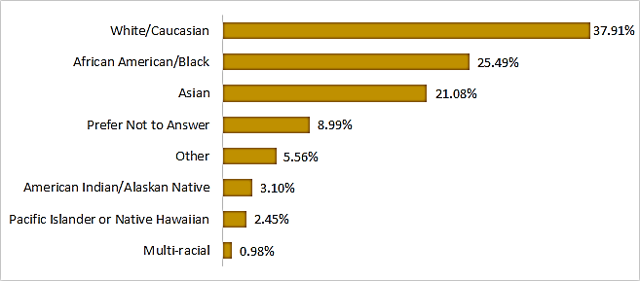
CPPP SURVEY HIGHLIGHTS: DEMOGRAPHICS
Figure 1. Participant’s Ethnicity (n=553)
Figure 2. Participant’s Race (n=612)
*Participant’s allowed to choose more than one category so percent total is more than 100%.
Notes:
OVERALL SUMMARY: Non-Hispanic, White, female
AC 1.6M
AA 10%
American Indian .6%
Asian 31%
NHPI.1%
White 39%
OVERALL SUMMARY STAKEOLDER IDENTITY:
Majority Provider (54.41%)
Family Member (39.43%)
Consumer (32.78%)
Faith Community (12.65%)
Other Stakeholder (4.16%)
Law enforcement (3.49%)
Active military/veteran (2.665)

Slide 13
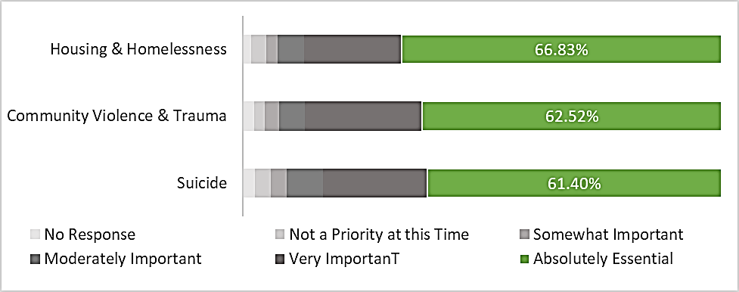
CPPP SURVEY HIGHLIGHTS: CHILD/ TAY CONCERNS
Figure 3. Top Three Concerns Related to Children/Youth/Transitional Age Youth (n=627)
Notes:
Q2-3: What concerns for specific age groups?
Top for both age groups is Housing/Homelessness
For Youth/TAY the other concerns are Community Violence and Trauma and Suicide
From African American, Faith-based, UELP Focus Groups
“subacute and acute beds in continuum of care facilities, and a quick release of 5150s and those on holding, we need an increased supply of licensed board and care”
Support and Advocacy as African-American youth.
Multigenerational approach that opens up to the therapy for entire families.
Literacy & life Skills programs
African youth often experience cultural shock and racial discrimination

Slide 14
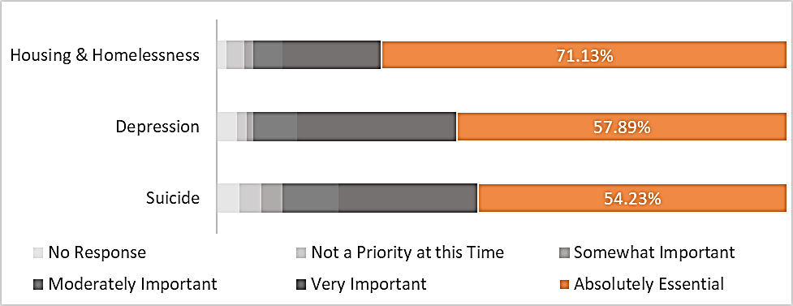
CPPP SURVEY HIGHLIGHTS: ADULT/OLDER ADULT CONCERNS
Figure 4. Top Three Concerns Related to Adult/Older Adult (n=627)
Notes:
For Adult/Older Adult the other concerns are Depression and Suicide
From African American, Faith-based, UELP Focus Groups
Advocacy for breaking the poverty cycle.
Older adults feel isolated and are not able to connect with their community and/or lack tech skills required to navigate social media/zoom etc.. During COVID-19. require technological coaching
Acknowledge AA elders typically holding all the pieces for themselves and their family members
Help for career changes due to loss of jobs/Financial education
Innovative and technology that helps adults increase their skills.
Trauma, stigma prevent adults from speaking to their children about the way trauma manifests (e.g. substance abuse)

Slide 15
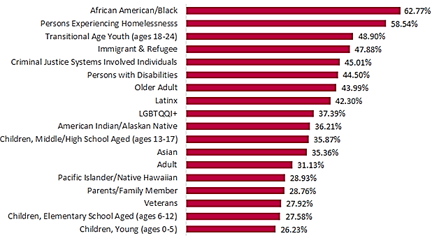
CPPP SURVEY HIGHLIGHTS: NOT ADEQUATELY SERVED BY SYSTEM
Figure 5. Populations or Groups not Adequately Served by System (n=591)
Notes:
From African American, Faith-based, UELP Focus Groups
African Refugees, Immigrants, and Asylum Seekers (n=7)
Black men – specifically TAY population (PTSD)
Impoverished AA women/mothers mothers who are Severely Mentally Ill (n=7) (speak about Gov. Proposal to increase funding for AA perinatal programs)

Slide 16
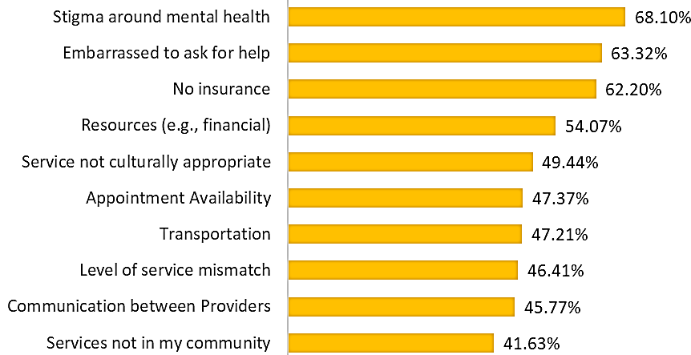
CPPP SURVEY HIGHLIGHTS: BARRIERS TO SERVICES
Figure 6. Barriers to Accessing Mental Health Services (n= 627)
Notes:
From African American, Faith-based, UELP Focus Groups
Racial stigma
distrust of the system
Stigma -? MH system
System does not acknowledge/allow non-traditional healers

Slide 17
EFFECTIVE PROGRAMS FOR AFRICAN AMERICANS
Peer coaching & navigators
Faith-based Community Outreach
Life groups and community gatherings
Beyond Emancipation
Evidence-based curricula created by African American researchers and/or practitioners
Notes:
A total of 557 unique ideas were submitted via the CPPP survey
Increasing peers in the workforce (n= 22)
“Use community members such as promotoras or health educators to provide mental health support to community members that are not high need.”
“Peer specialists should be present as an option to deal with individuals who are having or been in a crisis. The peer specialist has lived experience and can assist in the wellness of the client.”
Telehealth – individual and group (n=23)
“Online community mental health sessions (e.g., mindfulness).”
“Supporting clinical programs and consumers with greater access to telehealth. Supporting consumers with access to adequate cell phones with training to get set up with telehealth.”
Outreach to Educate about Services and Decrease Stigma (n=61)
“One idea is to have a roving mental health information vehicle. Sites and times where people can come to get more information via brochures, literature, etc, can be posted on various medias and handing out via postcards. Set times and sites with service on weekends also.”
“Create a cultural wellness center for API community with in language staff. Provide resource for outreach and engagement to reduce stigma.”
Care Coordination/Provider Communication (n=27)
“agreements that allow for transfer of case conferencing information to allow for continuity of care.”
“Collaborative Partnerships b/tween existing organizations, e.g. schools/health centers; faith based/cbo's; city & county; primary health/behavioral health.”
School-based Services (n=44)
“possibly adding full spectrum of services in elementary, middle, and high school similar to a full scale family resources centers; accessibility to tangible services from 7am to 5pm. Monday thru Friday. Possibly even adding a full scale family resource center at Laney, Chabot, Merritt, and Alameda community colleges.”
“Enhancing schools existing tiered support structures with tiered mental health services so that mental health providers are able to provide prevention and early intervention services. This allows schools to support students before their needs escalate to the point of medical necessity. Mental health providers are then freed up to serve all students, including those who may benefit from social skills groups that bolster protective factors and address risk factors before they escalate.”
Community and Home-base Services (n=69)
“Because of the limitations of Medi-Cal, I think more of these funds need to be utilized for Family Resource Centers and Early Childhood Mental Health Consultation. ECMHC has been proven to have positive impacts on development for children and FRC's have demonstrated impact on economic mobility of immediate neighborhood, even for those who don't directly receive services.”
“Have providers go the home, as often as necessary, like Trieste Italy does. Psychiatrists, Registered Nurses, Psychologists, etc. go to the home to PREVENT hospitalizations. This county does not have enough beds so this is the only way to help the SMI in crisis.”
Creativity and recreation-based therapies (n=23)
“Incorporating recreation, music, and the arts into mental health services and allowing that to be billable.”
“Engaging clients in ways that are not traditional mental health. Through culture specific healing practices, art, music, and connection to family and community.”
Integrate Culture (n=31)
“Culturally accepted practices (spirituality, rituals, gatherings).”
“More reliance on community and cultural knowledge as opposed to traditional book learning re: what's helpful for community members”
Supporting Families (n=14)
“allow billable support services to the family for collateral support, case management and linkages. If we improve the family's health, we improve the client's mental health as well”
“Family treatment centers that are holistic- treating mental health, education, job, housing, connections, etc... with the whole family.”
“there is an intervention for families who are struggling with their child's sexual orientation or gender identity; this intervention keeps kids in their family and prevents homeless youth.”
Evaluation (n=5)
“Better evaluation and follow-up on organizations who are partially or fully funded by the County, State & governmental agencies. Holding these community based programs more accountable to produce evidence base outcomes and a clear reduction in needed services for longterm mental health patients. Consequently, these programs are able to have a greater outreach to others' who may need mental health service support because there are more success stories among the mentally ill patient/ client who are no longer in need of Mental Health services and are able to re-enter the community, successfully."

Slide 18
CPPP SURVEY HIGHLIGHTS: INNOVATION THEMES
Community and Home-base Services
Outreach to Educate about Services and Decrease Stigma
School-based Services
Increasing peers in the workforce
Integrate Culture such as a rites of passage ceremony for youth
Care Coordination/Provider Communication
Telehealth – individual/groups such as creating digital villages or kinship networks on social media platforms
Creativity and recreation-based therapies
Supporting Families
Notes:
A total of 557 unique ideas were submitted via the CPPP survey
Increasing peers in the workforce (n= 22)
“Use community members such as promotoras or health educators to provide mental health support to community members that are not high need.”
“Peer specialists should be present as an option to deal with individuals who are having or been in a crisis. The peer specialist has lived experience and can assist in the wellness of the client.”
Telehealth – individual and group (n=23)
“Online community mental health sessions (e.g., mindfulness).”
“Supporting clinical programs and consumers with greater access to telehealth. Supporting consumers with access to adequate cell phones with training to get set up with telehealth.”
Outreach to Educate about Services and Decrease Stigma (n=61)
“One idea is to have a roving mental health information vehicle. Sites and times where people can come to get more information via brochures, literature, etc, can be posted on various medias and handing out via postcards. Set times and sites with service on weekends also.”
“Create a cultural wellness center for API community with in language staff. Provide resource for outreach and engagement to reduce stigma.”
Care Coordination/Provider Communication (n=27)
“agreements that allow for transfer of case conferencing information to allow for continuity of care.”
“Collaborative Partnerships b/tween existing organizations, e.g. schools/health centers; faith based/cbo's; city & county; primary health/behavioral health.”
School-based Services (n=44)
“possibly adding full spectrum of services in elementary, middle, and high school similar to a full scale family resources centers; accessibility to tangible services from 7am to 5pm. Monday thru Friday. Possibly even adding a full scale family resource center at Laney, Chabot, Merritt, and Alameda community colleges.”
“Enhancing schools existing tiered support structures with tiered mental health services so that mental health providers are able to provide prevention and early intervention services. This allows schools to support students before their needs escalate to the point of medical necessity. Mental health providers are then freed up to serve all students, including those who may benefit from social skills groups that bolster protective factors and address risk factors before they escalate.”
Community and Home-base Services (n=69)
“Because of the limitations of Medi-Cal, I think more of these funds need to be utilized for Family Resource Centers and Early Childhood Mental Health Consultation. ECMHC has been proven to have positive impacts on development for children and FRC's have demonstrated impact on economic mobility of immediate neighborhood, even for those who don't directly receive services.”
“Have providers go the home, as often as necessary, like Trieste Italy does. Psychiatrists, Registered Nurses, Psychologists, etc. go to the home to PREVENT hospitalizations. This county does not have enough beds so this is the only way to help the SMI in crisis.”
Creativity and recreation-based therapies (n=23)
“Incorporating recreation, music, and the arts into mental health services and allowing that to be billable.”
“Engaging clients in ways that are not traditional mental health. Through culture specific healing practices, art, music, and connection to family and community.”
Integrate Culture (n=31)
“Culturally accepted practices (spirituality, rituals, gatherings).”
“More reliance on community and cultural knowledge as opposed to traditional book learning re: what's helpful for community members”
Supporting Families (n=14)
“allow billable support services to the family for collateral support, case management and linkages. If we improve the family's health, we improve the client's mental health as well”
“Family treatment centers that are holistic- treating mental health, education, job, housing, connections, etc... with the whole family.”
“there is an intervention for families who are struggling with their child's sexual orientation or gender identity; this intervention keeps kids in their family and prevents homeless youth.”
Evaluation (n=5)
“Better evaluation and follow-up on organizations who are partially or fully funded by the County, State & governmental agencies. Holding these community based programs more accountable to produce evidence base outcomes and a clear reduction in needed services for longterm mental health patients. Consequently, these programs are able to have a greater outreach to others' who may need mental health service support because there are more success stories among the mentally ill patient/ client who are no longer in need of Mental Health services and are able to re-enter the community, successfully."

Slide 19
… HOW TO HELP SPREAD THE WORD
VISIT : The ACMHSA website to view the Three-Year Plan at Https://ACMHSA.ORG
CIRCULATE: Information amongst your network
ATTEND: MHAB Public Hearing on 9/21/20 at 5PM

Slide 20
MHSA CONTACT INFORMATION
MHSA Website: www.ACMHSA.org
MHSA Email: MHSA@acgov.org
ACBH Tel Main Line: (510) 567-8100

